Slide 1



Differentiated Thyroid Cancer Prediction Model
SC1015 Mini Project
Group 8: Claire Chia Wan Ni (U2430719H), Narmandakh Nomt (U2430263A)

Slide 2

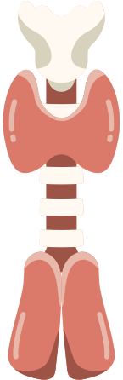

What is it?
Most Common Cause of Thyroid Cancer
Accounts for > 90% of Thyroid Cancer cases
30% of patients experience recurrence
Causes Clinical Complications
Emotional Distress and Financial Burden
CHALLENGE:
UNPREDICTABILITY
Why is it unpredictable?
Assessed by Physicians’ Experience and Generalized Clinical Guidelines
Overlook nuanced, personalised factors that lead to recurrence
Originates from the Follicular Cells
Introduction

Slide 3
Our Objective
Identify hidden patterns across clinical attributes
Replace Clinical Decision-Making
Complement Clinical Decision Making in flagging high-risk patients earlier
Allows for more tailored monitoring and treatment plans
Problem Statement:
Are we able to Predict Recurrence of Thyroid Cancer based on Individuals’ Physical Attributes?
Introduction

Slide 4

Exploratory data analysis

Slide 5


Exploratory Data Analysis
Thyroid_Diff.csv
Tracks 17 Clinicopathologic Features
383 Thyroid Cancer Patients
Long-term, curated dataset
Exploratory Data Analysis

Slide 6
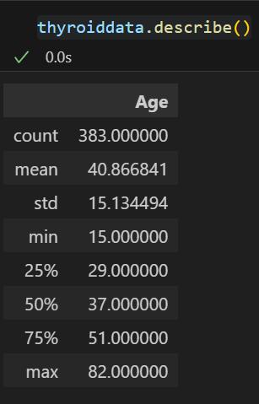
Statistical Profile
Thyroid_Diff.csv
Exploratory Data Analysis

Slide 7
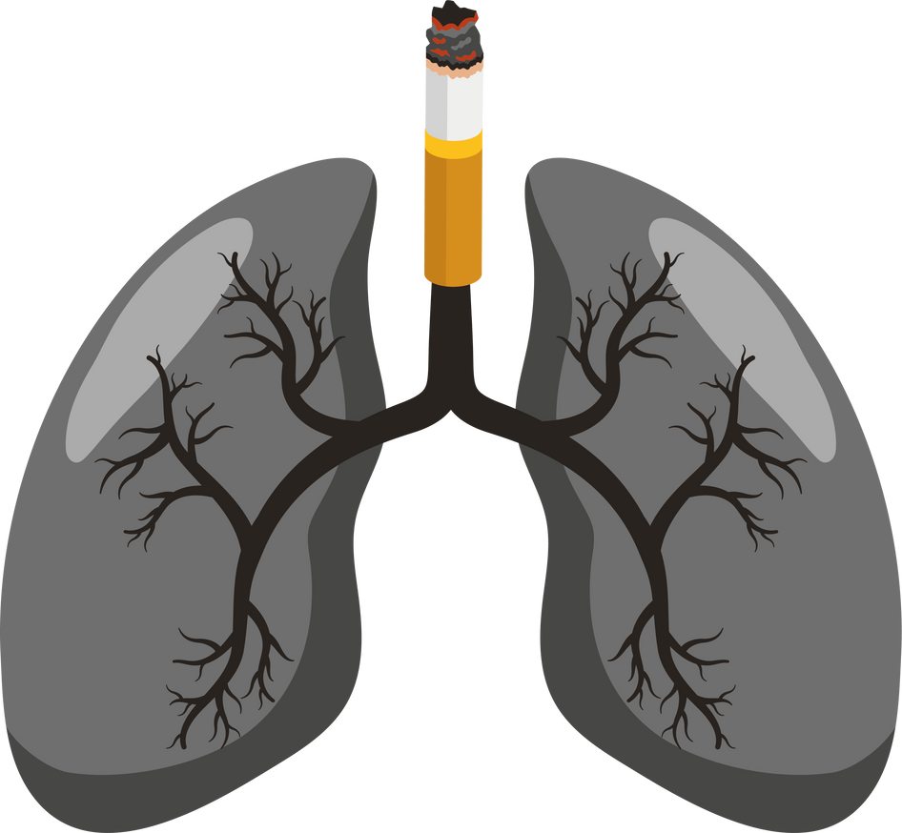
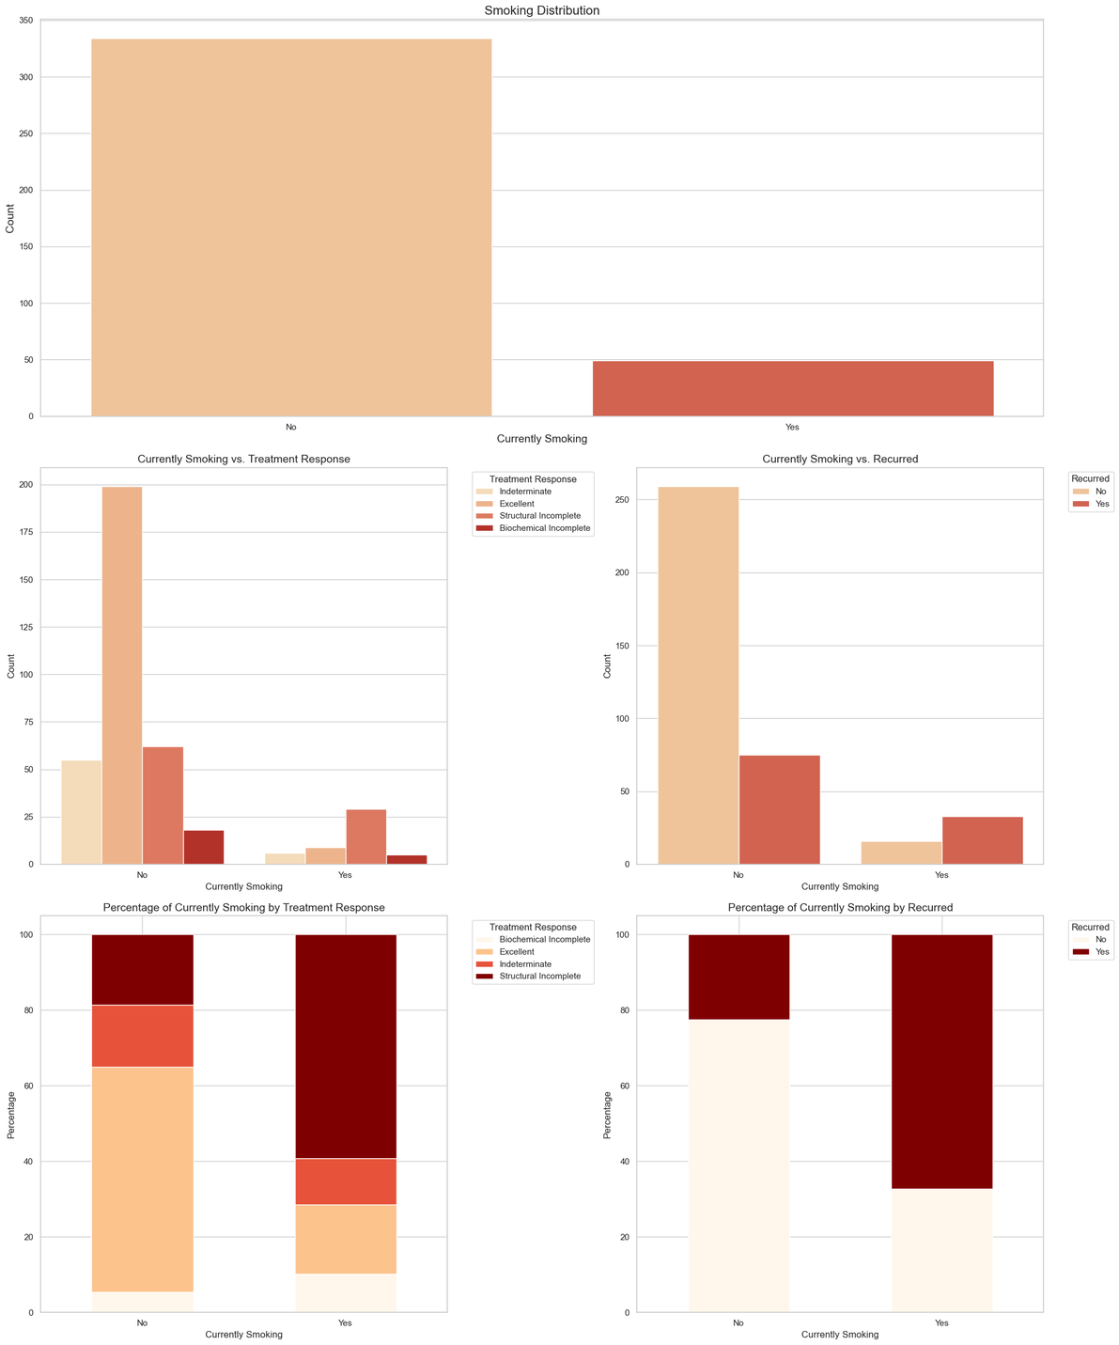

Data Visualisation
Categorical Visualisation of Smoking
Count Plots
Visualise distribution of smokers based on given data
Bar Graphs
Visualise statistics of smokers based on our calculated percentages
Exploratory Data Analysis

Slide 8

Data Visualisation
Categorical Visualisation of Smoking
2. Smoking reduces the effectiveness of the initial thyroid cancer treatment.
-17% of patients who are currently smoking experiences excellence in initial treatment response, with about 60% experiencing structural incomplete.
3. Smoking increases the likelihood of Thyroid Cancer Recurrence.
- About 67% experiences a recurrence of the thyroid cancer, which is significantly higher than the < 25% of patients who aren't smoking .
1. Majority of Thyroid Cancer patients do not smoke.
While most patients were non-smokers, smokers consistently showed poorer recovery and higher recurrence rates, marking smoking as a strong risk factor for our model.
Exploratory Data Analysis
*More explained in the notebook

Slide 9
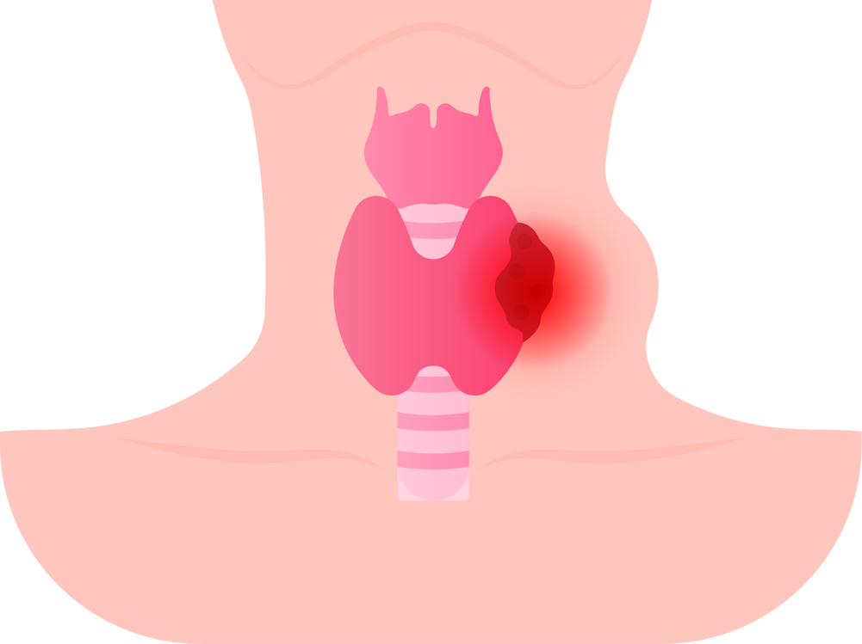
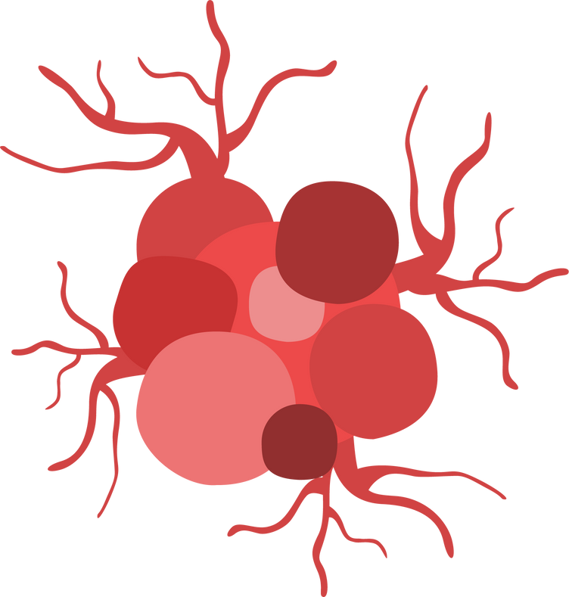
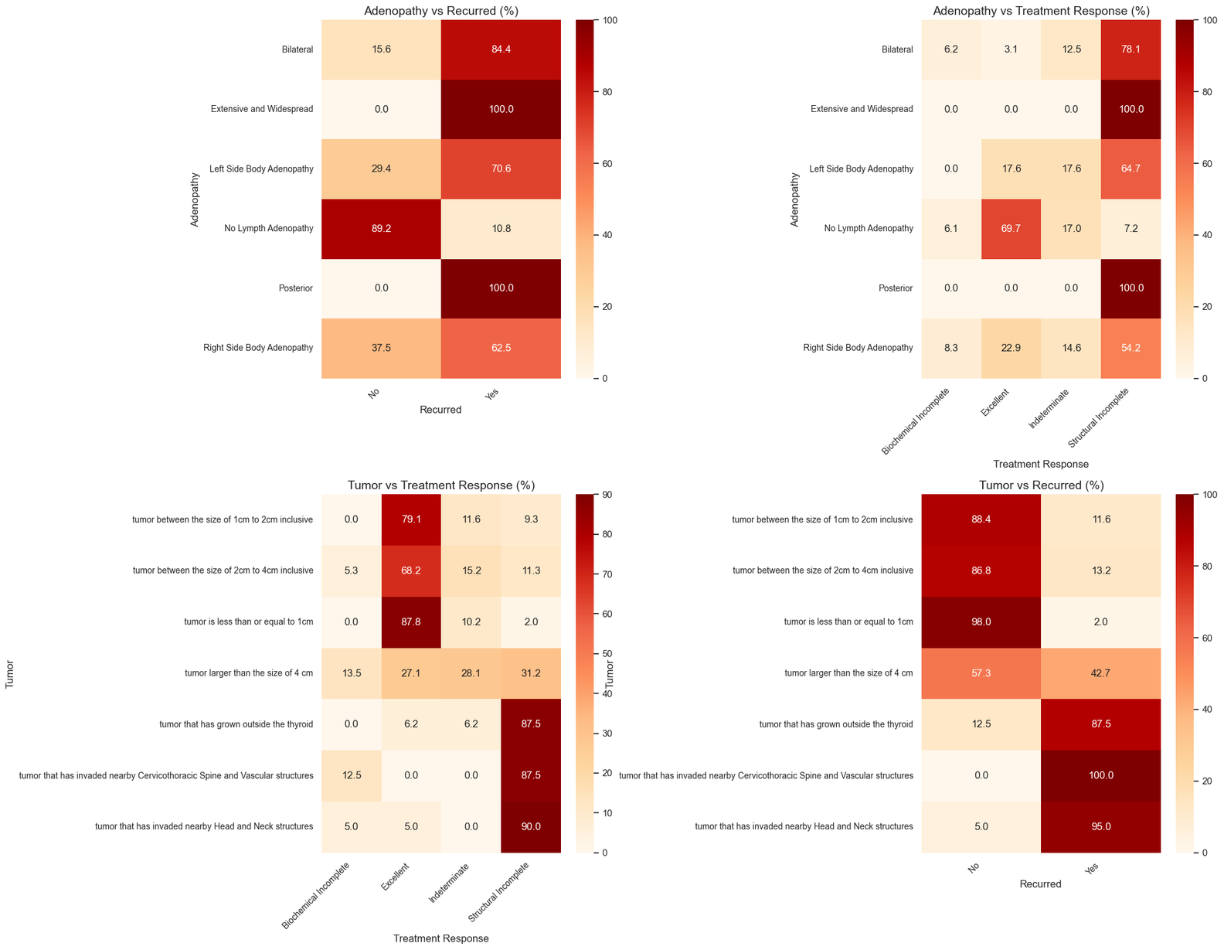

Data Visualisation
2. Bivariate Heatmap of Adenopathy and Tumor (Type)
Heatmaps
Strong Intensity Gradient and correlation, easier for visualisation
Patients with Adenopathy or Tumors extending beyond the thyroid had a much higher likelihood of recurrence and poorer treatment outcome, suggesting these conditions are major clinical indicators.
Exploratory Data Analysis
*More explained in the notebook

Slide 10
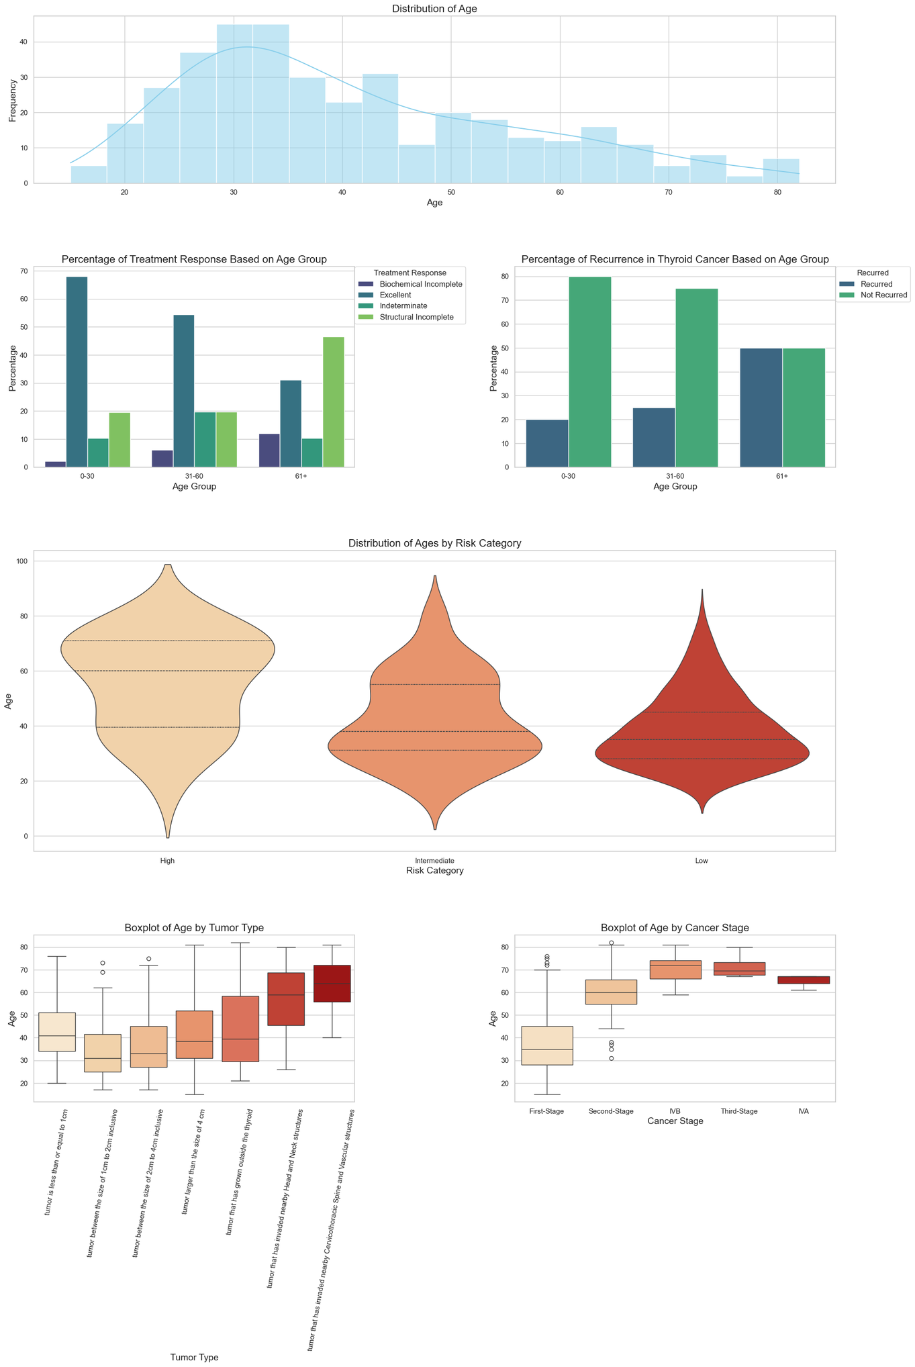
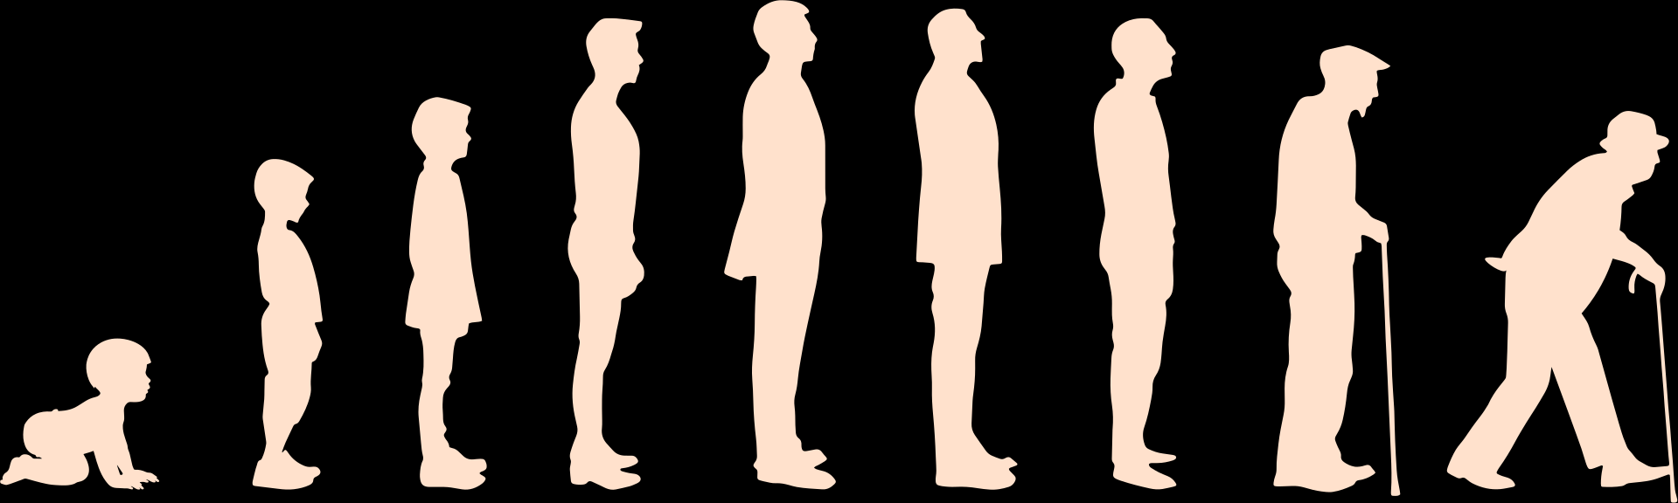
Data Visualisation
3. Univariate and Distribution Visualisation of Age
Histogram
Shows the frequency distribution of age, helping us see which age ranges are most common in the dataset.
Bar Graph
Visualise statistics of responses and recurrence by age based on our calculated percentages
Exploratory Data Analysis
*More explained in the notebook

Slide 11
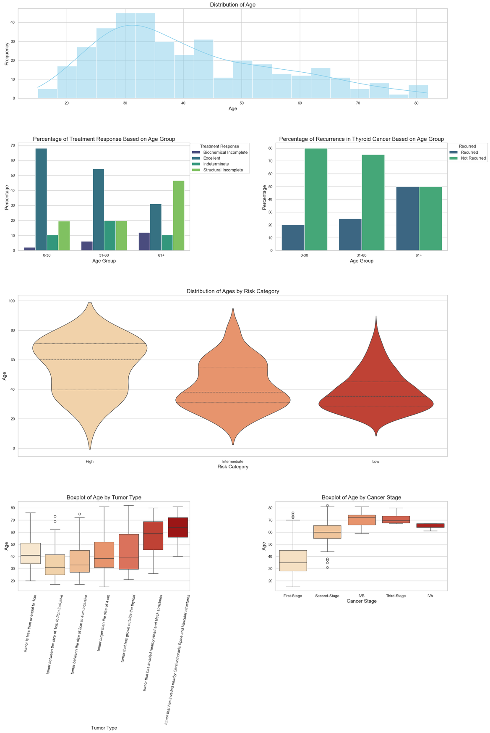
Data Visualisation
3. Univariate and Distribution Visualisation of Age
Violin Plot
Shows distribution and density of age data across recurrence outcomes
Illustrates how common certain age ranges are
Box Plot
To identify the median, spread, and outliers in age data across different recurrence outcomes.
Exploratory Data Analysis
*More explained in the notebook

Slide 12
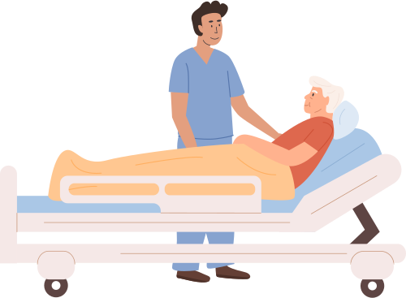
Data Visualisation
3. Univariate and Distribution Visualisation of Age
Older patients have a higher probability of recurrence and poorer treatment response.
Recurrence risk increases steadily with age.
Exploratory Data Analysis
*More explained in the notebook

Slide 13
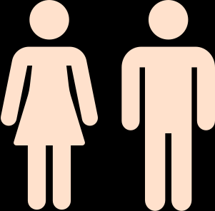
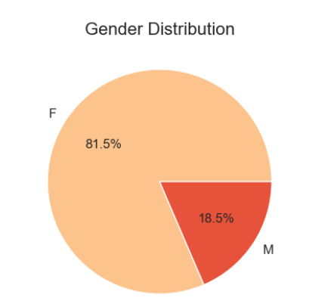
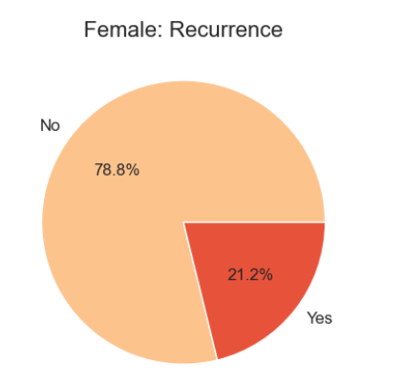
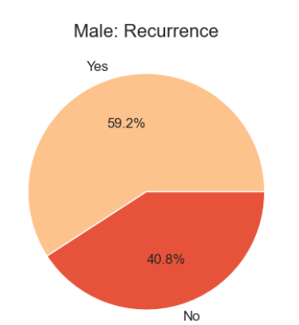
Data Visualisation
4. Categorical Visualisation of Gender
Pie Chart
Illustrates proportional distribution of male and female patients
While more females are likely to be diagosed, Male patients are more likely to experience severe complications that increases likelihood of recurrence and poorer treatment response.
Exploratory Data Analysis
*More explained in the notebook

Slide 14

Data Preparation

Slide 15
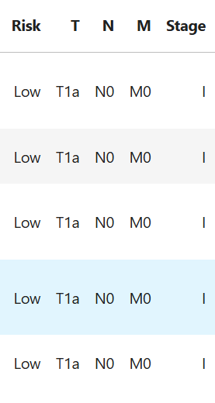
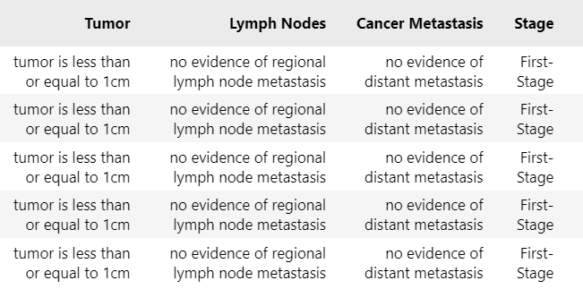

Exploratory data analysis
Medical termonoligies / abbreviations
Understandable phrases
Data Preparation

Slide 16
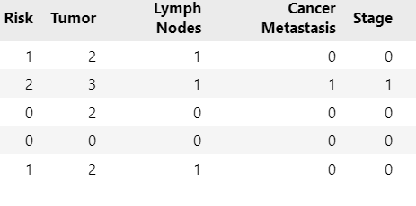
2. Machine learning
Encoding categorical variables into numerical ones
Data Preparation

Slide 17
2. Machine learning
Initializing train and test datasets
75% - 25%
The Target Variable: "Recurrence”
The Predictor Variables: *Varies
X: "Age", "Gender", "Smoking History"
X2: "Age", "Gender", "Smoking History", "Currently Smoking", "Adenopathy"
X3: "Age", "Gender", "Currently Smoking", "Smoking History", "Adenopathy", "Risk", "Treatment Response"
X4: All given variables
Data Preparation

Slide 18
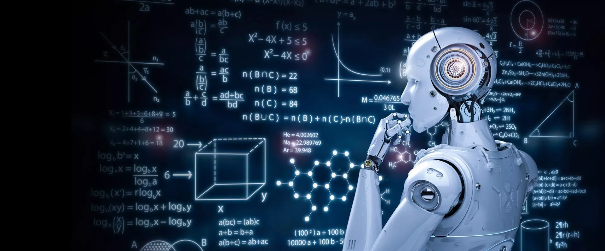
Machine Learning
Decision Tree Classifier
Random Forest Classifier
Clustering
Overall Best Model

Slide 19
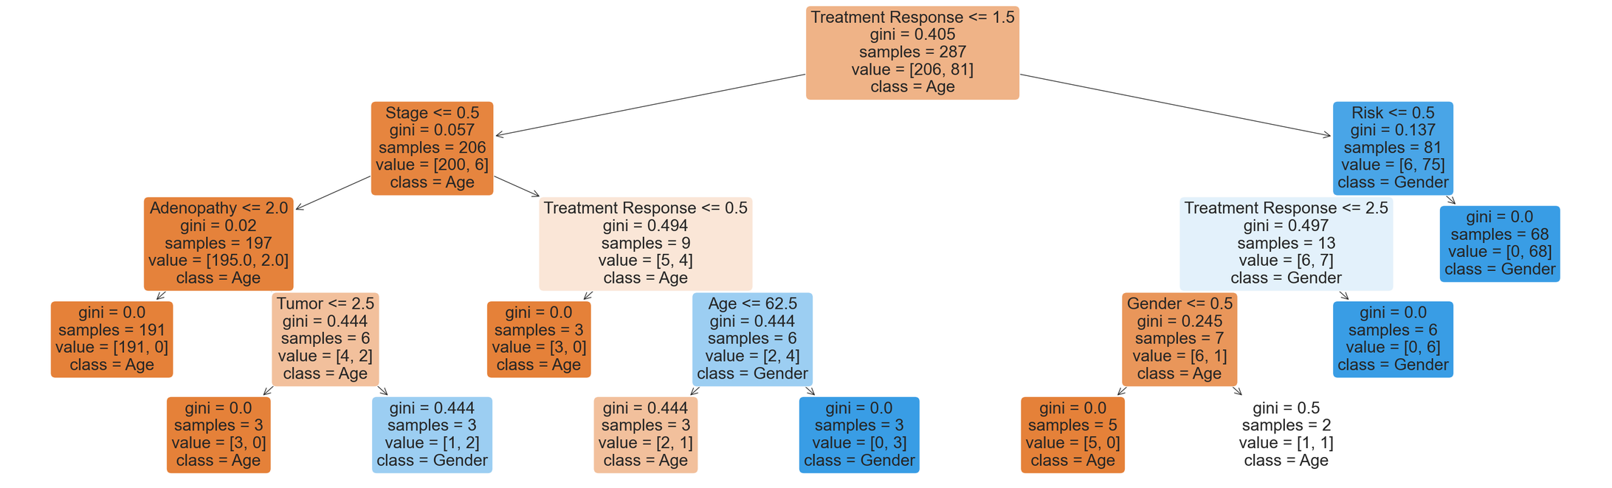
Decision tree Classifier
Accuracy
X3_test
Train dataset: 81.5% - 98.9%
Test dataset: 63.5% - 93.7%
Machine Learning

Slide 20
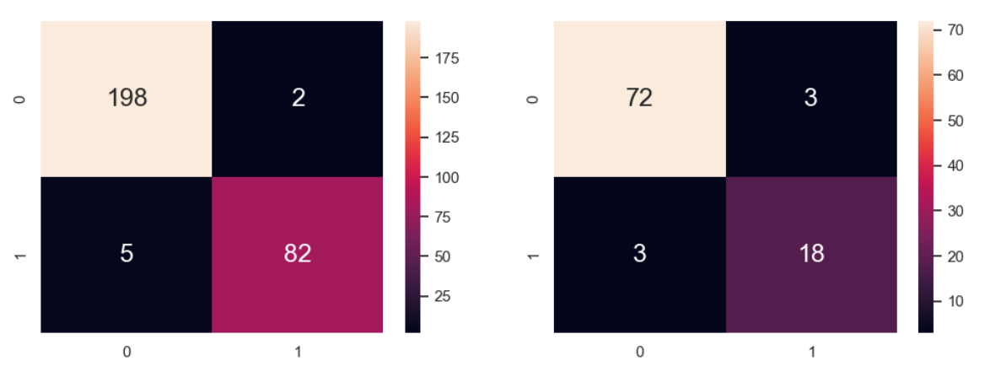
Decision tree Classifier
X3_test
Train Dataset
Test Dataset
tpr:
fnr:
fpr:
tnr:
tpr:
fnr:
fpr:
tnr:
0.14286
0.9754
0.02381
0.960
0.0246
0.9762
0.04
0.8571
Machine Learning

Slide 21
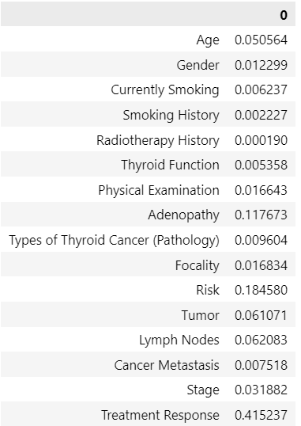
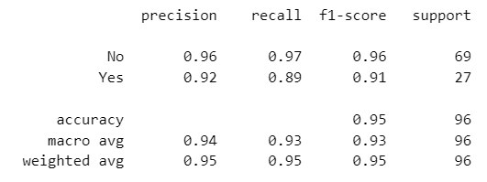
2. Random Forest Tree
Accuracy Range: 0.6145 - 0.947
X4_test
Machine Learning

Slide 22
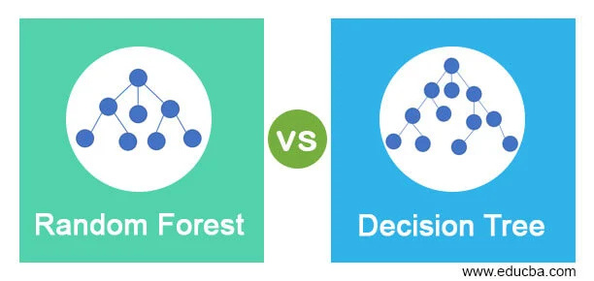
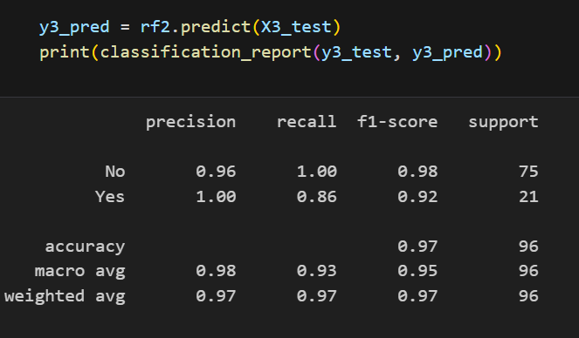
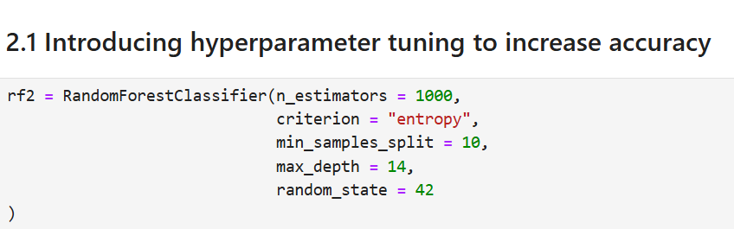
2. Random Forest Tree
(with hyperparameters)
Accuracy Range: 0.66 - 0.96
X3_test
Machine Learning

Slide 23
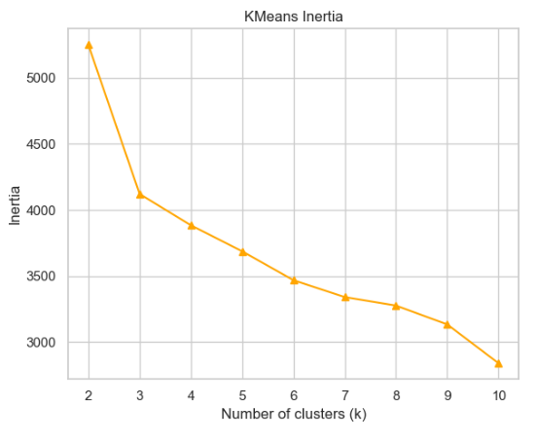
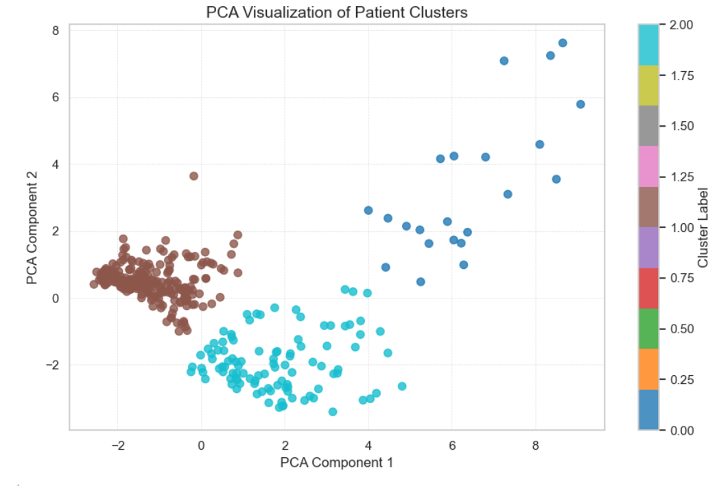
3. K-Clustering
KMeans Inertia
Key advantages
Optimal n of clusters = 3
Min overlapping & density
Machine Learning

Slide 24


4. Overall Best Model
(Integration)
Accuracy: 98%
Machine Learning

Slide 25

Insights &
recommendations

Slide 26


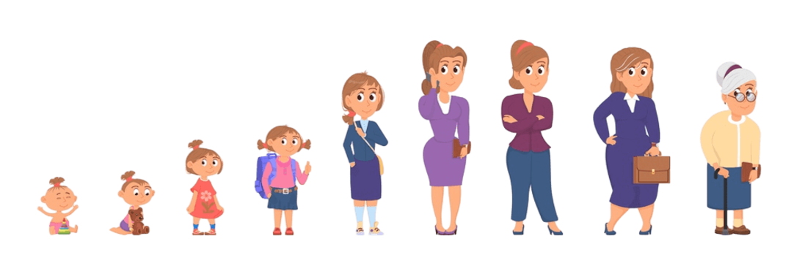
Insights
Through our analysis, we found strong relation of recurrence with the following:
Age - The older the patient is, the more likely to suffer from cancer
recurrence
Adenopathy / Tumor type - Patient with lymphatic spread should
be considered high-risk even before recurrence signs
Smoking Habit - It is directly related to worse treatment response
Gender - Male patients have higher recurrence rate
Response to initial cancer treatment - Patients with bad
medical history should have regular follow-up.
Insights & Recommendations

Slide 27



RECOMMENDATIONS
Improve data granularity and balance
Explore ensemble or time-based models
Embed model outputs into clinical settings
Insights & Recommendations

Slide 28
Thank you!

